Slide 1

Business Intelligence Analytics Mini Project
Saudi Telecom
A Use Case analysis presented by Vishal Angelo Gracian (SSN School of Advanced Career Education, Chennai, Tamil Nadu – India (1/12/2023)

Slide 2
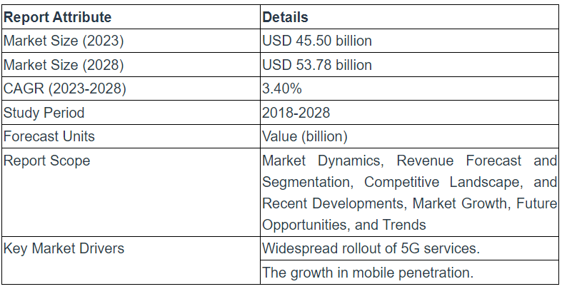
Intelligence Report
Saudi Arabia is one of the largest ICT markets in the Middle East region.
The market is estimated at USD 45.50 billion in 2023.
It is expected to register a CAGR of 3.40% during the forecast period.
Report Summary
Reference: https://www.globenewswire.com/news-release/2023/08/18/2728030/0/en/Saudi-Telecom-Market-Revenues-to-Reach-USD-53-78-billion-by-2028-Market-Size-Share-Forecasts-Trends-Analysis-Report-by-Mordor-Intelligence.html

Slide 3
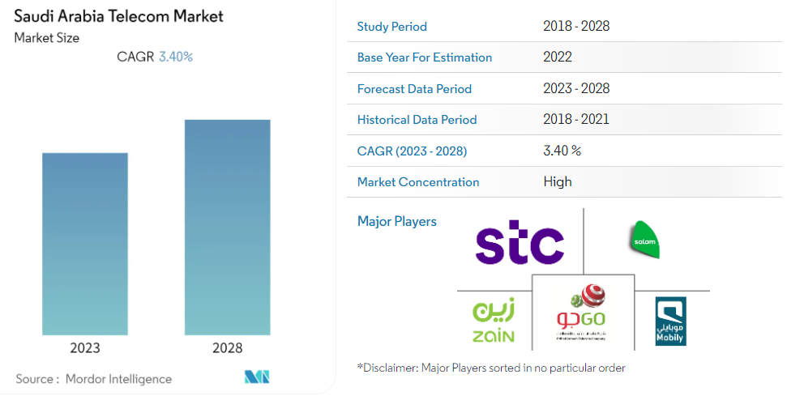
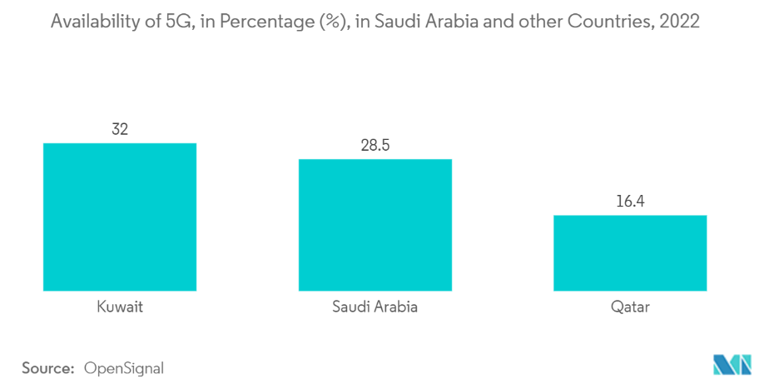
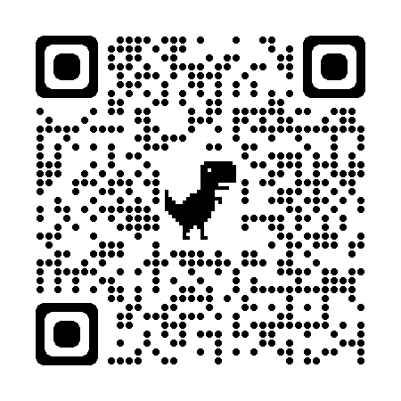

Slide 4

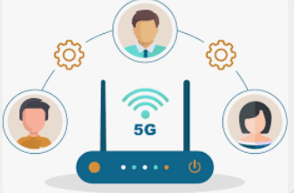


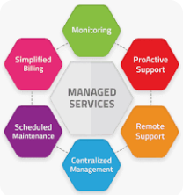
Segmentation
The Saudi Arabia Telecom Market can be segmented based on the following,
Segment 1: Service Type
Mobile Services Fixed-Line Services Internet Services
Digital Services Managed Services

Slide 5






Segment 2: Consumer Type
Individual Consumers Business Consumers
Segment 3: Technology
4G/LTE Fiber Optics Wi-Fi/Wireless
Satellite Communication

Slide 6







Segment 4: Industry Verticals
Healthcare Education Banking and Finance
Retail and E-commerce Manufacturing
Transportation and Logistics Government and Public Sector

Slide 7
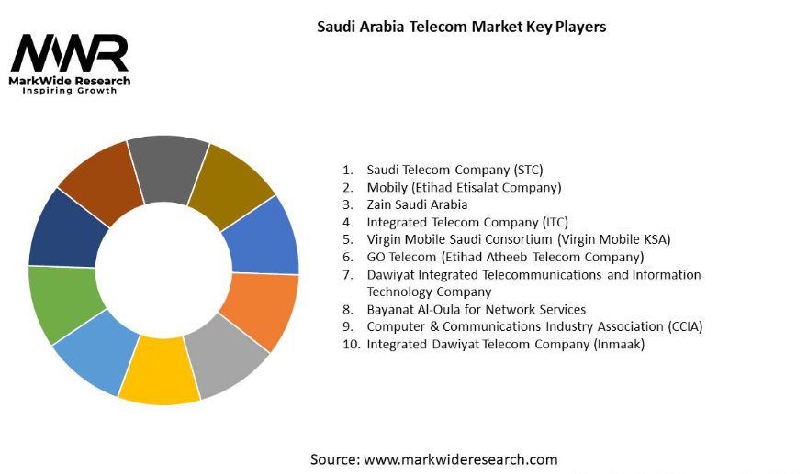
To enhance connectivity and providing cutting edge technology
Saudi Telecom Company Pros
Vast Reach – Offering extensive coverage. Diverse Services – Wide array of services. Innovation – Investing in technical advancements.
Saudi Telecom Company Cons
Regulatory Environment – Policies affecting pricing.
Competition – From other key players in the market.

Slide 8

Reference: https://www.stc.com.sa/content/dam/groupsites/en/pdf/EarningsPresentationQ2-2022En.pdf

Slide 9
Market Overview
Saudi Telecom Company (STC)
Who are they?
What do they commit?
Whom do they empower?
A leading telecommunications provider in Saudi Arabia and the Middle East.
Established in 1998.
Transitioned from a government run entity to a business competing open market.
Digital transformation makers offering
- Innovative services in mobile.
- Fixed-line telephony.
- Internet, and digital solutions.
Excellence and a focus on inspiring innovation.
Drive technological advancements and connectivity
Empowering Business and Individuals across the region.
Keeping Consumers in mind.
Supporting Government Organizations.

Slide 10
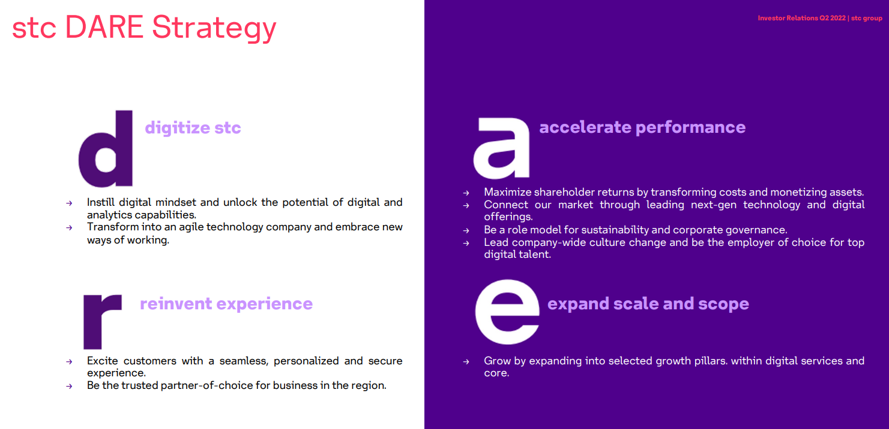
Reference: https://www.stc.com.sa/content/dam/groupsites/en/pdf/stc-presentation-Q1-2022-NEW.pdf

Slide 11
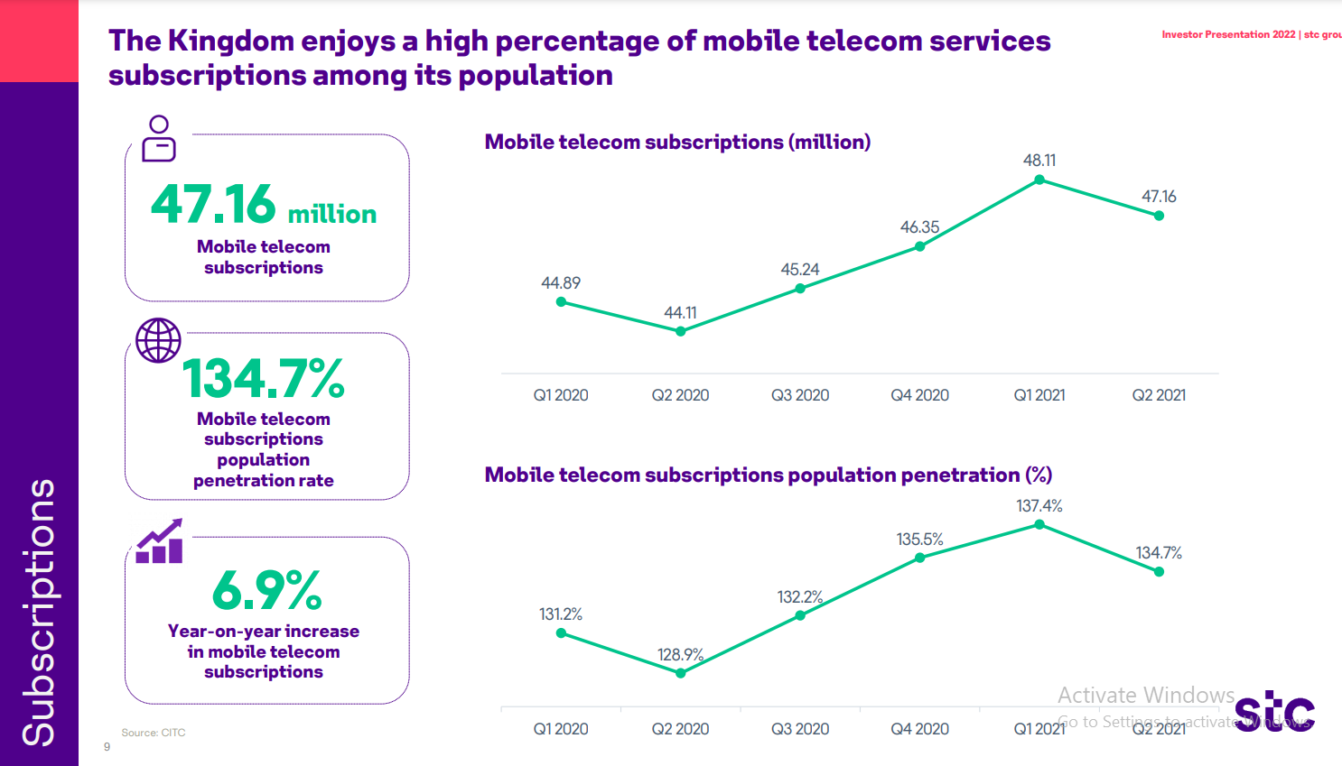
Reference: https://www.stc.com.sa/content/dam/groupsites/en/pdf/stc-presentation-Q1-2022-NEW.pdf

Slide 12
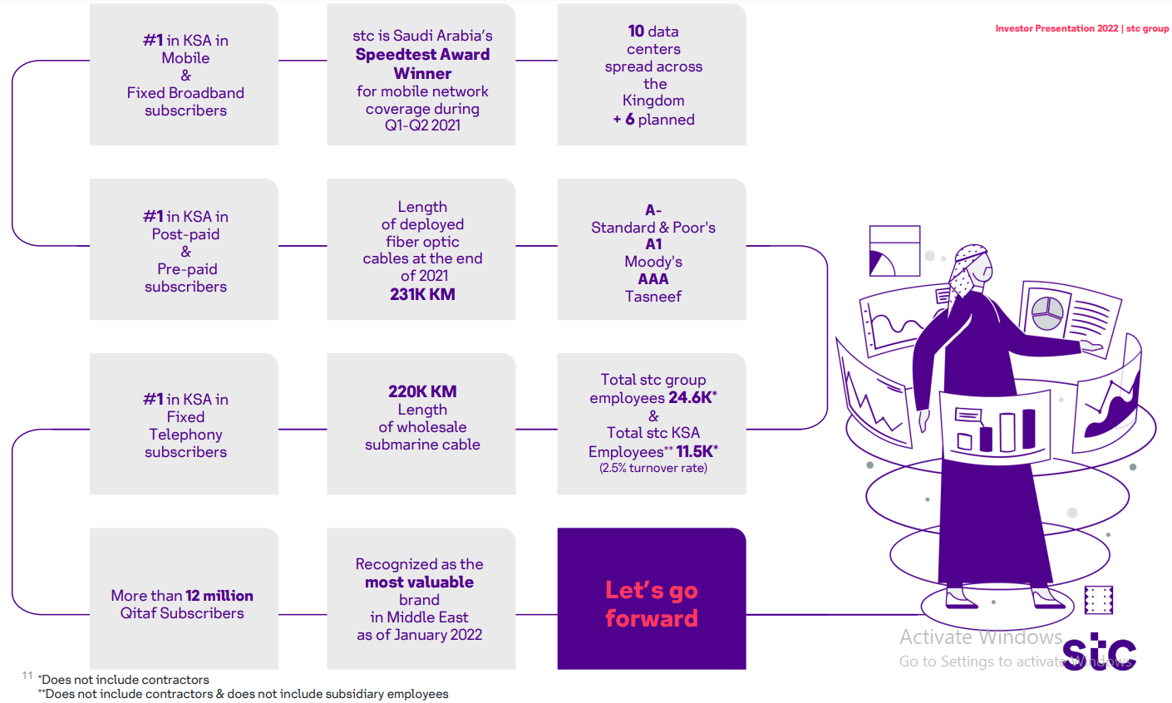
Reference: https://www.stc.com.sa/content/dam/groupsites/en/pdf/stc-presentation-Q1-2022-NEW.pdf

Slide 13




STC's customer base from 2021 June to 2023 June
STC's customer base
Grew by 13.64% from 2021 to 2022
And by 12% from 2022 to 2023.
Factors influencing the growth
Introduction of new mobile services
Fixed-line services
Its strong brand reputation

Slide 14
Key Challenges Faced By STC
The below challenges of STC from June 2022 to June 2023 are as follows,
Reference: https://markwideresearch.com/saudi-arabia-telecom-market/
Global Economic Headwinds
Inflationary pressures
Supply chain disruptions
Geopolitical instability
Competition
Aggressive pricing strategies
Shifting customer preferences
Regulatory Landscapes
Evolving regulations
Data localization and sovereignty
Government intervention
Technological Advancements
Rapidly Changing Technologies
Data Privacy Concerns
Environmental and Sustainability Concerns
Rising Energy Consumption
E-waste management
Climate Change Resilience
Internal Transformation
Integration of acquired assets
Talent acquisition and retention
Cyber security threats

Slide 15
Problem Statement
In a rapidly evolving telecommunications and digital landscape, Saudi Telecom Company (STC) seeks to maintain its competitive edge, enhance customer experiences, and drive sustainable growth. The company faces the challenge of balancing network expansion, digital transformation, customer centricity, cyber security, environmental responsibility, talent acquisition, strategic partnerships, and financial resilience.

Slide 16
Key Objectives
Expand 5G coverage and modernize network infrastructure.
Leverage AI, ML, and cloud technologies for digital transformation.
Enhance customer experience and develop personalized offerings.
Strengthen cyber security measures and protect data privacy.
Promote sustainability and minimize environmental impact.
Attract, retain, and develop a skilled workforce.
Form strategic partnerships and expand into new markets.
Optimize pricing strategies and diversify revenue streams.
Reference 1: https://markwideresearch.com/saudi-arabia-telecom-market/
Reference 2: https://www.arabnews.com/node/2335241/business-economy

Slide 17



Slide 18
Recent Trends
Liberalization of the Telecom Sector
A Need to Develop Broadband Infrastructure
Competition a Challenge to Mobile Entry
Consumer remains at the center of the data.
Network Evolution Shapes the future of Telecom Industry
Government Policy
Reference 1: https://www.mordorintelligence.com/industry-reports/saudi-arabia-telecom-market/market-trends
Reference 2: https://www.shearman.com/~/media/files/newsinsights/publications/2016/09/saudi-arabia-publications/telecoms-in-the-kingdom-of-saudi-arabia--an-overview.pdf

Slide 19
Liberalization of the Telecoms Sector
Undergoing privatization program to liberalize the market since 1998.
Partnership with Huawei to provide MVNE services.
In light of Saudi Vision 2030 and the National Transformation Program 2020, the Kingdom’s telecoms market is expected to continue growing alongside the demand for digital services.
Need To Develop Broadband Infrastructure
To retain Fiber backbone by continuing to work on Agile Optical Network
investment in high-speed infrastructure will be a strategic priority
international interest in such projects.
Competition a Challenge to Mobile Entry
Key players such as STC, Zain and Mobily are looking to expand their services to develop triple or quad-play offerings for customers by bundling services, in an effort to fend off the MVNOs.
Reference: https://www.shearman.com/~/media/files/newsinsights/publications/2016/09/saudi-arabia-publications/telecoms-in-the-kingdom-of-saudi-arabia--an-overview.pdf

Slide 20
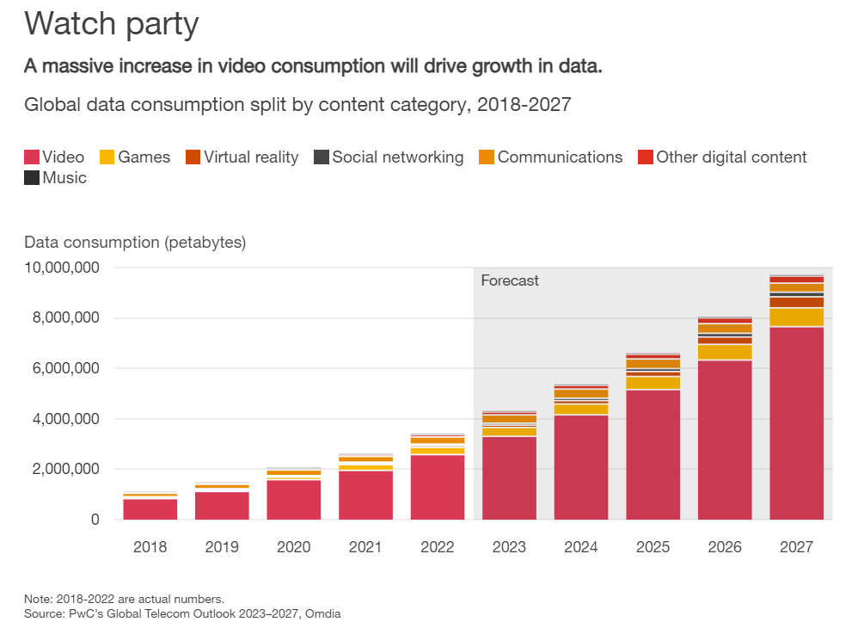
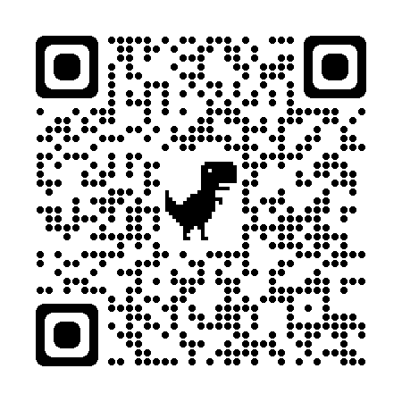
Consumer remains at the center of the data
Reference: https://www.pwc.com/gx/en/industries/tmt/telecom-outlook-perspectives.html

Slide 21
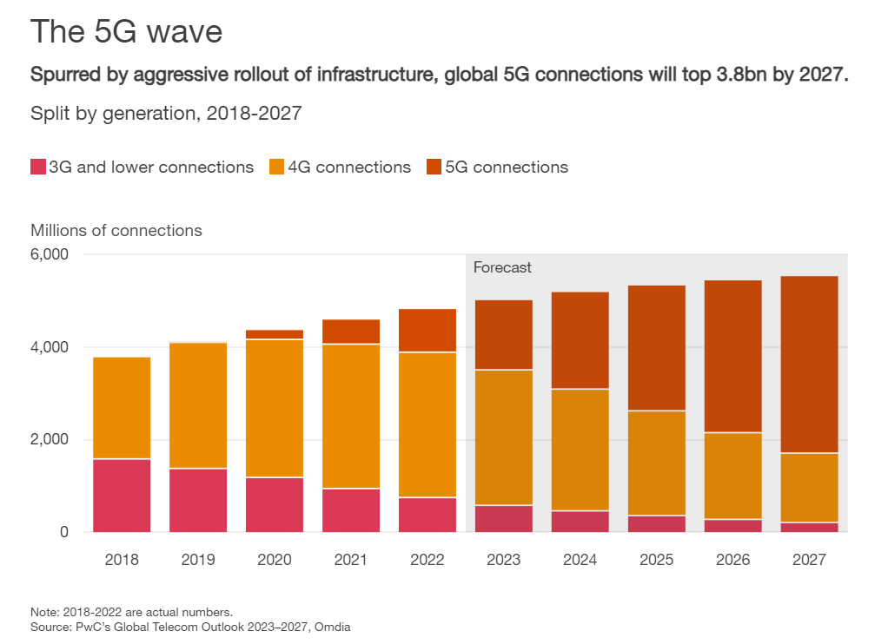
Network Evolution Shapes the future of Telecom Industry
Reference: https://www.pwc.com/gx/en/industries/tmt/telecom-outlook-perspectives.html

Slide 22


Government Policy
The growth of telecoms in the Kingdom as a national priority.
Investment in infrastructure and high tech projects driven by strong demand for smartphones and high-speed networks.
Data privacy and Security Laws
Taxation and Fiscal Policies
“Saudi Arabia has made updates to its telecommunication's regulatory regime with the new Telecommunications and Information Technology Act. The Act was published on 10th June 2022 and make effective on 7th December 2022.”
Reference 1: https://www.linkedin.com/pulse/new-telecommunications-information/
Reference 2: https://www.shearman.com/~/media/files/newsinsights/publications/2016/09/saudi-arabia-publications/telecoms-in-the-kingdom-of-saudi-arabia--an-overview.pdf

Slide 23
Telecommunications and Information Technology Act
Important Changes
Telecom services don't require public stock for subscription anymore.
Approval needed prior to substantial ownership changes for service providers.
Certificate needed for significant senior management changes by service providers.
CST (Communications, Space & Technology Commission) empowered to filter internet, restrict access to specific content.
New obligations under Saudi's Data Protection Law effective September 2023.
Royal approval emphasizes Cyber Security importance, especially for service providers.
Reference: https://www.linkedin.com/pulse/new-telecommunications-information/
Aim:
Promote Digital Transformation
Strong entrepreneurial innovation and research
Achieving competition benefits
Rise of new AI technologies.
Who does the Act implement too?
The Act stipulates service providers.
For implementing proper prices
Detail further anti-competition practices

Slide 24
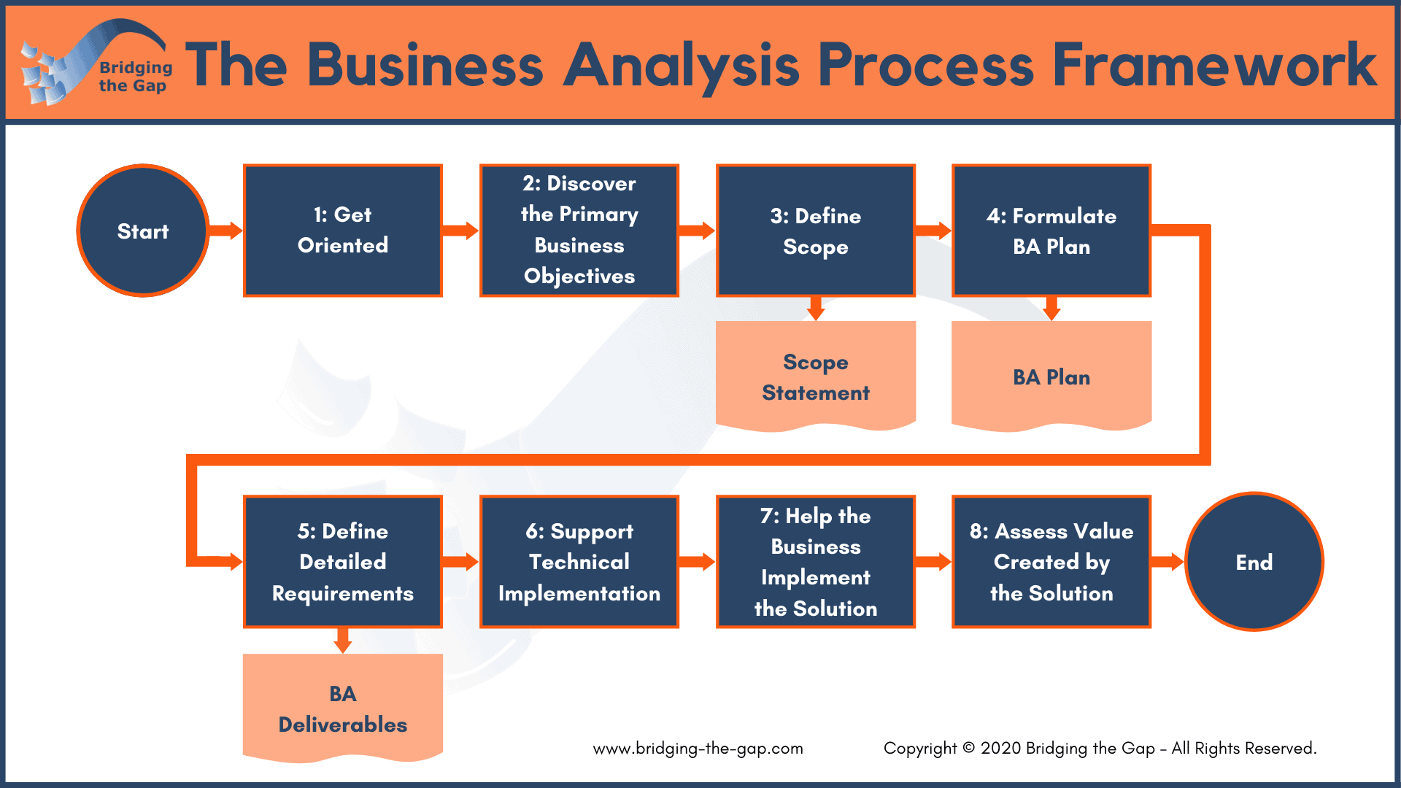

Slide 25

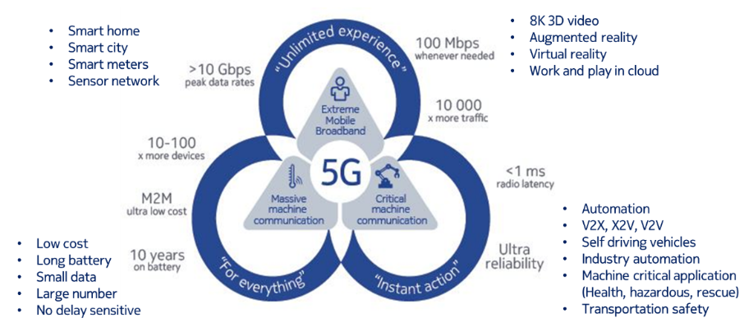
Reference: https://www.linkedin.com/pulse/stc-transformation-where-coming-from-going-dr-abdullah/

Slide 26
Proposed Solutions
Accelerate 5G deployment and invest in fiber-optic network expansion.
Implement AI-driven solutions for customer insights, service optimization, and personalized experiences.
Adopt cloud-based solutions for scalability, cost efficiency, and improved service delivery.
Fortify cyber security infrastructure, implement data governance frameworks, and stay vigilant against evolving threats.
Reduce carbon footprint, promote sustainable waste management, and engage in digital inclusion initiatives
Invest in employee training and development programs, foster a culture of innovation, and attract top talent
Establish strategic partnerships with technology providers, content creators, and industry players
Balance revenue growth with customer satisfaction, explore new revenue streams, and maintain financial discipline.
Reference: https://www.pwc.com/gx/en/industries/tmt/telecom-outlook-perspectives.html

Slide 27
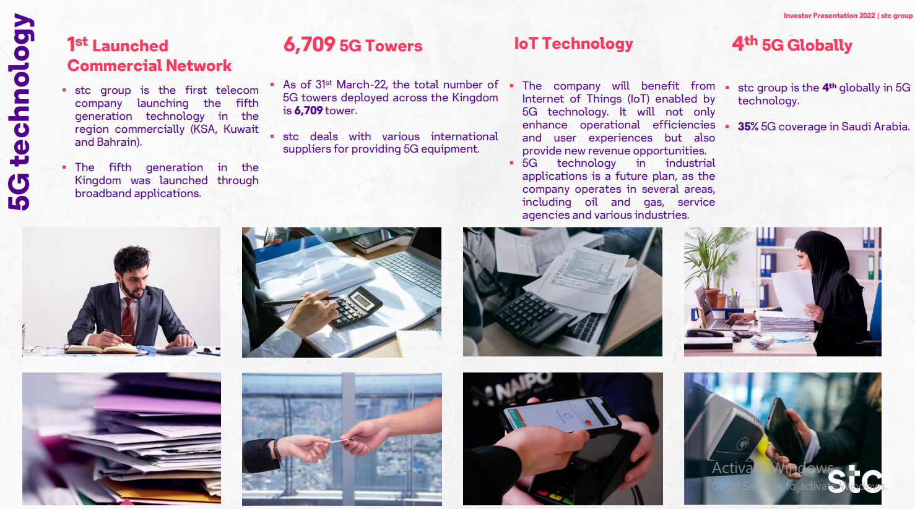

Slide 28
Bridging the Gap between Businesses and Consumers
Business to Business (B2B)
Comprehensive suite of B2B solutions include the following,
Connectivity Solutions:
To operate seamlessly and efficiently.
Cloud Solutions:
Infrastructure as a Service (IaaS), Platform as a Service (PaaS), and Software as a Service (SaaS),
Managed Services:
To help businesses offload their IT responsibilities and focus on their core business
Industry-Specific Solutions:
To address the unique needs and challenges.
Business to Customer (B2C)
B2C segment caters to individual consumers,
Mobile Services:
Suit the diverse needs of consumers, including prepaid, postpaid, and family plans.
Fixed Broadband:
to enjoy seamless internet access for work, entertainment, and communication.
Digital Entertainment:
To cater to the growing demand for digital content.
FinTech Solutions:
Mobile wallets, payment gateways, to manage their finances conveniently and securely.
Smart Home Solutions:
To control their home appliances, lighting, and security systems remotely

Slide 29
Digitalization to Deliver Better Customer Experiences
STC Objective for Digitalization
A data-driven approach to customer lifecycle management
To optimize customer experiences
To decrease churn
To automate more features
Improve customer satisfaction
To increase revenues
Breakthrough’s in partner with Teradata
Microsoft Fabric and Azure Marketplace
- Facilitates risk-free AI/ML exploration in a server less cloud, allowing data experts to innovate freely.
Unleash the Value of AI and ML Quickly and at Scale with Teradata and AWS
- Overcome common AI and ML challenges to swiftly and expansively unlock enterprise-scale analytics.
Unlocking the Full Value of Your Data
- to harness vast data sets from diverse sources for precise business insights.
Reference: https://www.teradata.com/Resources/Case-Studies/Saudi-Telecom-Company-Calls-on-Digitalization-to-Deliver-Better-Customer-Experiences

Slide 30
Teradata
Other Partners of STC
Cisco:
Collaborations in networking, cyber security, and digital solutions.
Huawei:
Partnerships in telecommunications infrastructure, 5G technology, and digital transformation.
Microsoft:
Joint initiatives in cloud services, software development, and digital transformation.
Ericsson:
Collaboration in mobile infrastructure, 5G technology, and network solutions.
IBM:
Partnerships in cloud computing, AI, and data analytics.
Nokia:
Collaborations in telecommunications technology and infrastructure.
Oracle:
Partnerships in database solutions, cloud services, and enterprise software.
SAP:
Collaborations in enterprise software, business intelligence, and digital transformation.
Reference: https://www.teradata.com/Customers/Saudi-Telecom-Company
A data management and analytics company.
Provides solutions and services related to data warehousing, analytics, and consulting.
Association With Saudi Telecom
Data Management Solutions:
- Utilize Teradata for data handling
- Storing and organizing data
- Analyzing Telecom data
Analytics and Business Intelligence:
- Extracting Valuable insights from data
- Customer behavior analysis
- Network optimization
- Strategic Decision Making
Consulting and Support:
- Best practices
- Implementation support
- Optimizing data infrastructure
- Analytics capabilities

Slide 31
Saudi Telecom Company (stc), uses artificial intelligence (AI) and machine learning to segment and connect with its customers in highly personalized ways.

Slide 32
Data Analytics in STC
Descriptive Analytics: Measures such as average revenue per user (ARPU), churn rates, and network traffic patterns.
Diagnostic Analytics: Data drilling, data mining, and correlation analysis.
Predictive Analytics: Regression analysis, time series forecasting, and machine learning algorithms.
Prescriptive Analytics: Simulation modeling, optimization algorithms, and decision support systems.
Customer Segmentation and Profiling: Enables personalized marketing campaigns, targeted service offerings, and improved customer satisfaction.
Network Traffic Analysis and Optimization: Network traffic modeling, anomaly detection, and route optimization algorithms
Fraud Detection and Prevention: Pattern recognition, anomaly detection, and risk scoring models.
Marketing Analytics and Campaign Optimization: Campaign attribution modeling, web analytics, and customer journey mapping.
Supply Chain Optimization and Inventory Management: Demand forecasting, inventory optimization, and logistics routing algorithms.
Risk Management and Financial Analysis: Financial modeling, risk assessment algorithms, and scenario planning.

Slide 33
References for Data Analytics
Reference 1: https://www.stc.com.sa/content/stcgroupwebsite/sa/en/investors/financial-reports/reports/annual-reports.html
Reference 2: https://hub.misk.org.sa/programs/skills/virtual-work-experience-data-analysis-at-stc/
Reference 3: https://solutions.com.sa/case-studies/
Reference 4: https://www.researchgate.net/publication/352752888_The_Value_of_Big_Data_Analytics_Pillars_in_Telecommunication_Industry
Reference 5: https://www.arabianbusiness.com/business/429779-stc-reveals-plans-for-the-future-of-digital-communications-technology-in-saudi-arabia

Slide 34
Key Milestones And Achievements
The below key Milestones and Achievements of STC from June 2022 to June 2023 are as follows,
Network Expansion and Infrastructure
Financial Performance
Digital Transformation
continued…
5G Roll Out: Coverage to over 70% of the population. Fiber Optic Network: Reached over 90% of households, enabling HSI access.
International Cable Investments: Undersea cable projects for global connectivity
Revenue Growth: Steady revenue exceeding market expectations. Profitability: Healthy profit margins despite global economic challenges. Dividend Distribution: Consistent dividend payouts to shareholders.
Cloud Adoption: Launched cloud-based services for businesses and individuals.
Artificial Intelligence: Operation solutions for improving efficiency and customer service.
FinTech Initiatives: Mobile wallet & financial services for digital financial inclusion.

Slide 35
Customer Centricity
International Expansion
Additional Highlights
Enhanced Customer Experience
- New self-service channels and improved customer support platforms. Personalized offerings
- Developed data-driven targeted marketing and service recommendations. Community Engagement
- Supported various social initiatives and digital literacy programs.
Strategic Partnerships:
- Alliances with regional and global players to tap into new markets.
Investment in Emerging Technologies:
- Explored opportunities in areas like block chain and Internet of Things (IoT).
Brand Recognition:
- Increased STC's global brand presence and reputation.
Sustainability Efforts:
- Environmental initiatives like green data centers and solar power adoption.
Human Capital Development:
- Invested in employee training and talent acquisition programs
Cyber security:
- Strengthened cyber security infrastructure and awareness campaigns.
Notes:
Overall, STC has demonstrated remarkable progress across various sectors, solidifying its position as a leading telecommunications and technology provider in the region.

Slide 36
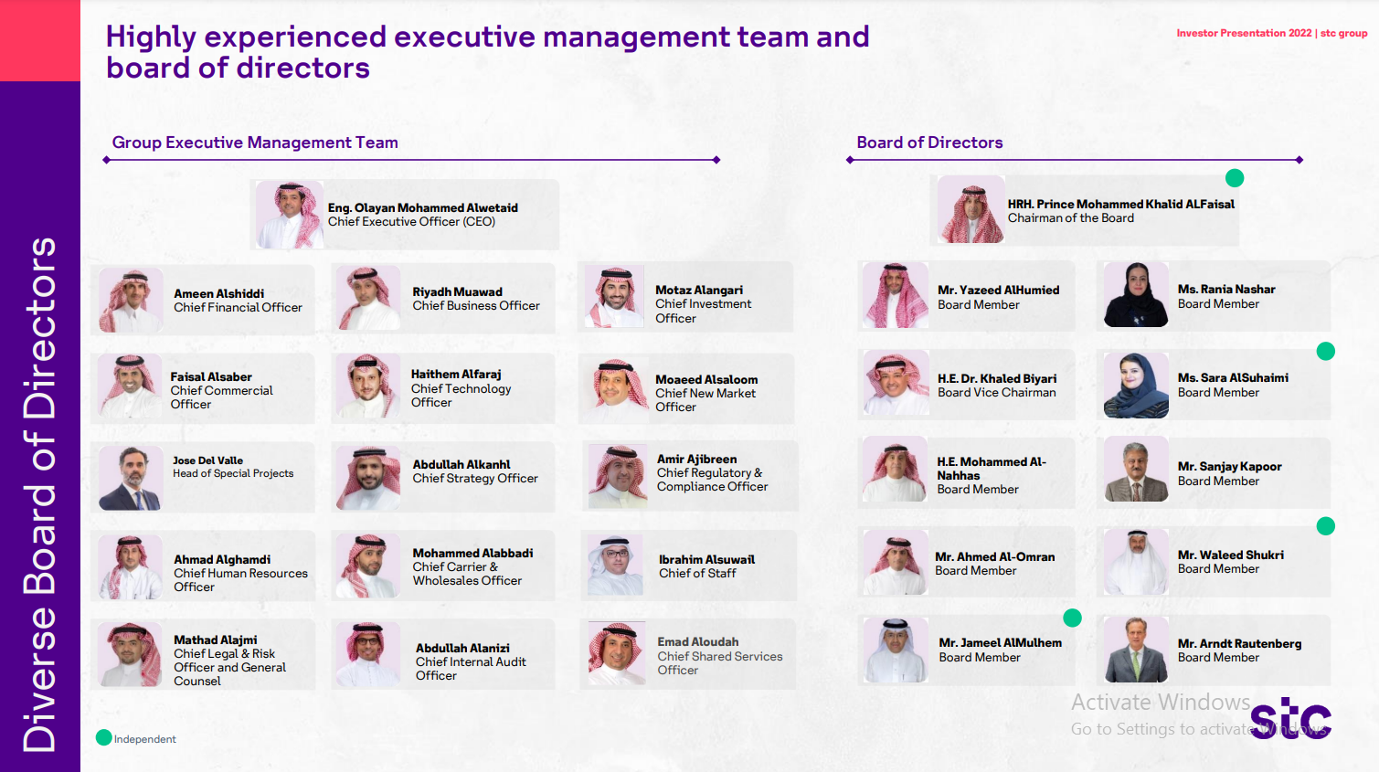
Reference: https://www.stc.com.sa/content/dam/groupsites/en/pdf/stc-presentation-Q1-2022-NEW.pdf

Slide 37


